Slide 1
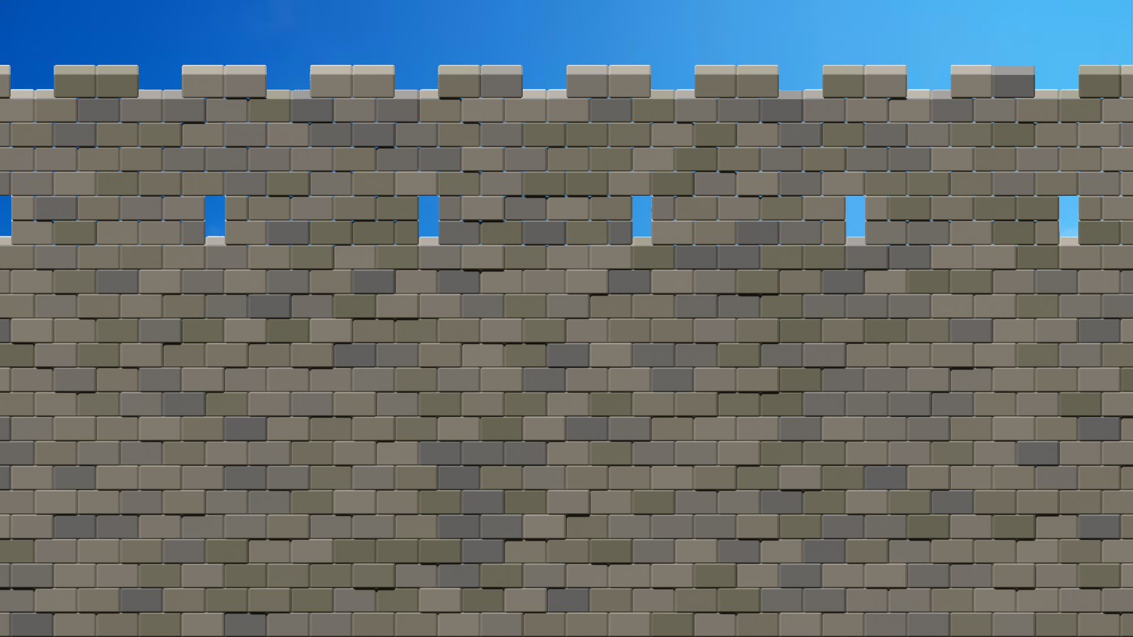
Wallther,
don’t let the Wall falter!
Wallther,
don’t let the Wall falter!
Your ancestors rely on you!
Defend your Legacy!
Defend the Wall!
Your ancestors rely on you!
Defend your Legacy!
Defend the Wall!

Slide 2
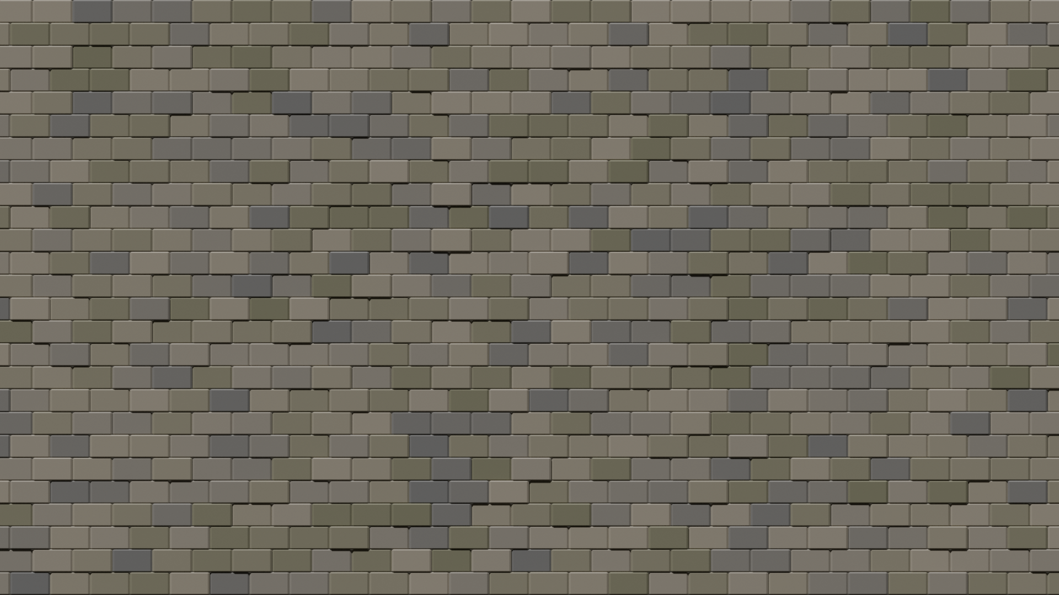
Roadmap
Roadmap
Feedback
The Paper Prototype
So what did we change?
Feedback
The Paper Prototype
So what did we change?

Slide 3
Feedback
Feedback
The Good
The Bad
Wallther
Fast-Paced Arcade
Backstory
Repetitive
No Clear Goal
What’s happening?

Slide 4
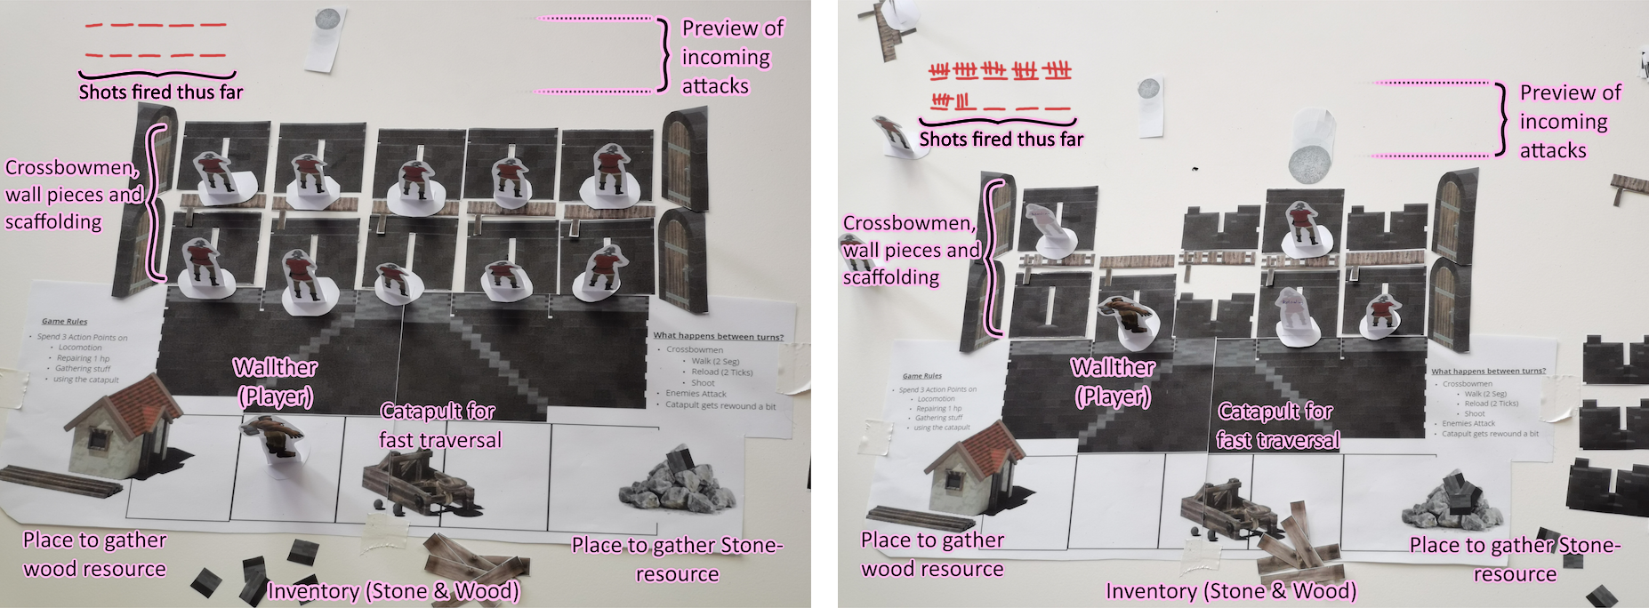
The Paper Prototype
The Paper Prototype

Slide 5
Changelog
Changelog
Increasing Wallther’s carrying capabilities
Catapult
Centered
Player can aim anywhere
Indicators for enemy attacks
Wall-ther → Wallther
Wallther remains a pacifist
Increasing Wallther’s carrying capabilities
Catapult
Centered
Player can aim anywhere
Indicators for enemy attacks
Wall-ther → Wallther
Wallther remains a pacifist

Slide 6
